Slide 1

Airbnbs in the Netherlands
DS-210 Final Project
Ali Schuh

Slide 2

Presentation Outline
Introduce the Data
Background Information
Research Question
Exploratory Data Analysis & Visualizations
Models & Statistics
Beginning Model & Statistics
Transformation Time
Final Model & Statistics
Answers to Research Questions
Conclusion
Future Research

Slide 3
Introducing the Data
Found data set on data.world
Created 2 years ago
6,334 Airbnb locations in the Netherlands, majority in Amsterdam
Variables included basic information about the locations
Some variables relating to the rating of the Airbnb
33 columns
7,833 observations
Each row/observation represents an individual stay at an Airbnb location.

Slide 4

Background Information
Airbnb: a place to stay that is rented out by the owner of the house, apartment, etc.
Can rent out anything from a single room to the whole house/apartment
Each property is unique
Website is used to post locations you want to rent or to rent locations

Slide 5
Research Question
What factors have an impact on the price of an Airbnb?
Is there a combination of factors that have a strong effect on price?
The factors in consideration are:
number of bedrooms
number of bathrooms
room type
minimum nights of stay
overall rating
property type
number of people the Airbnb accommodates.

Slide 6
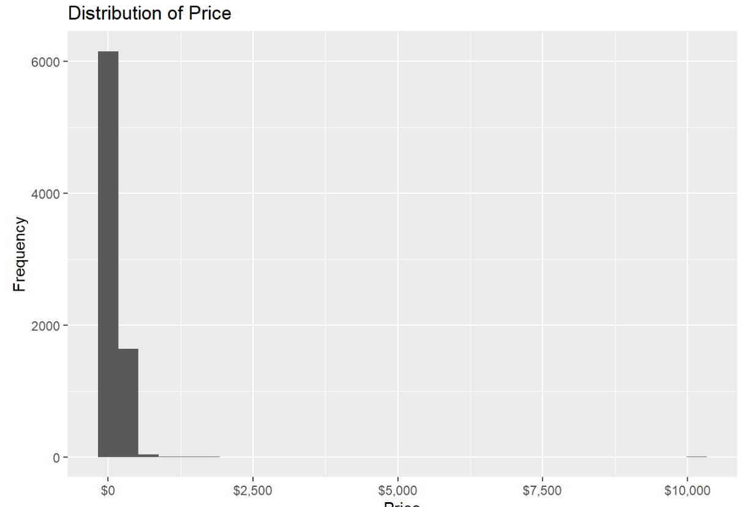
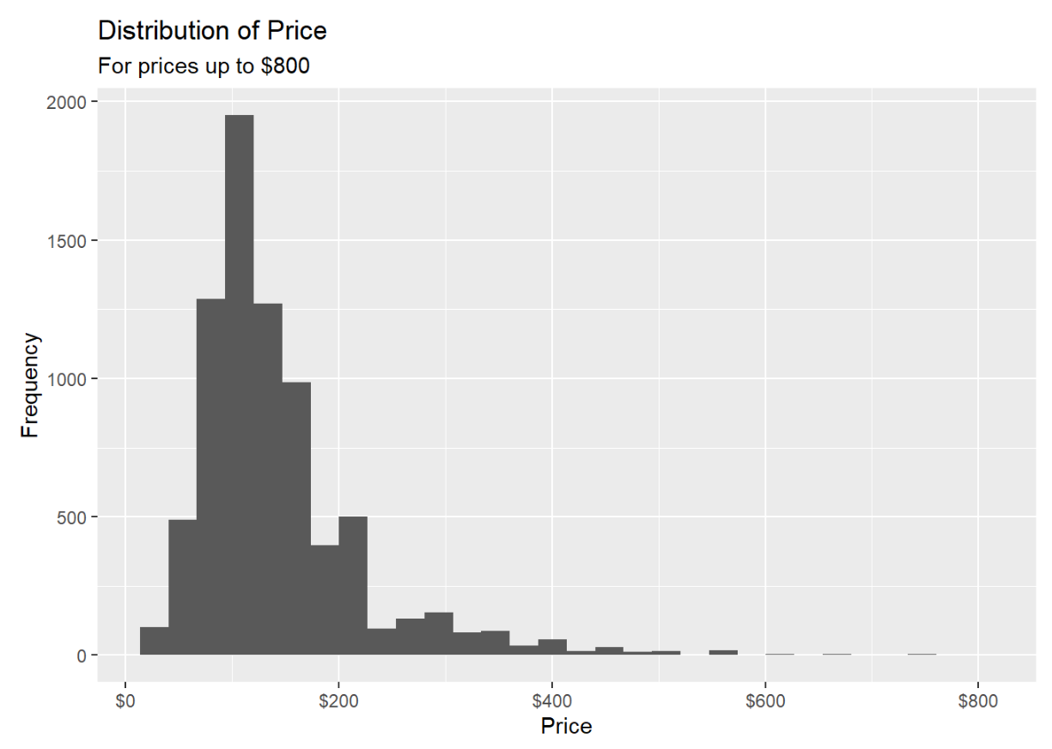
Exploratory Data Analysis & Visualizations
Data Wrangling
Converting price (euros) to dollars
Filtering outliers for price variable
Changed variable types for important variables
Filter out “NA” values for some variables

Slide 7
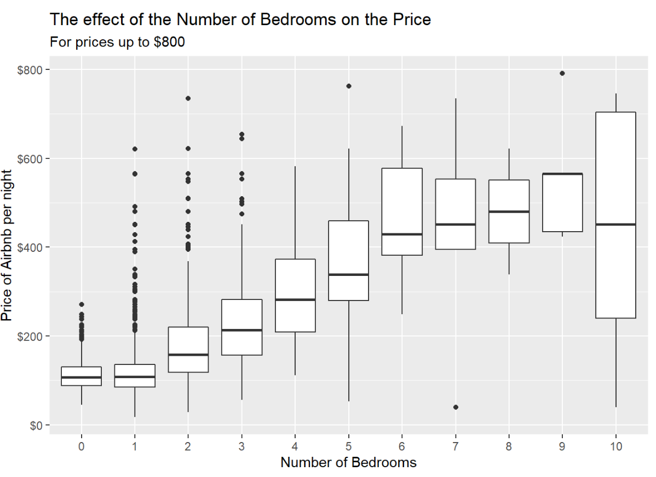
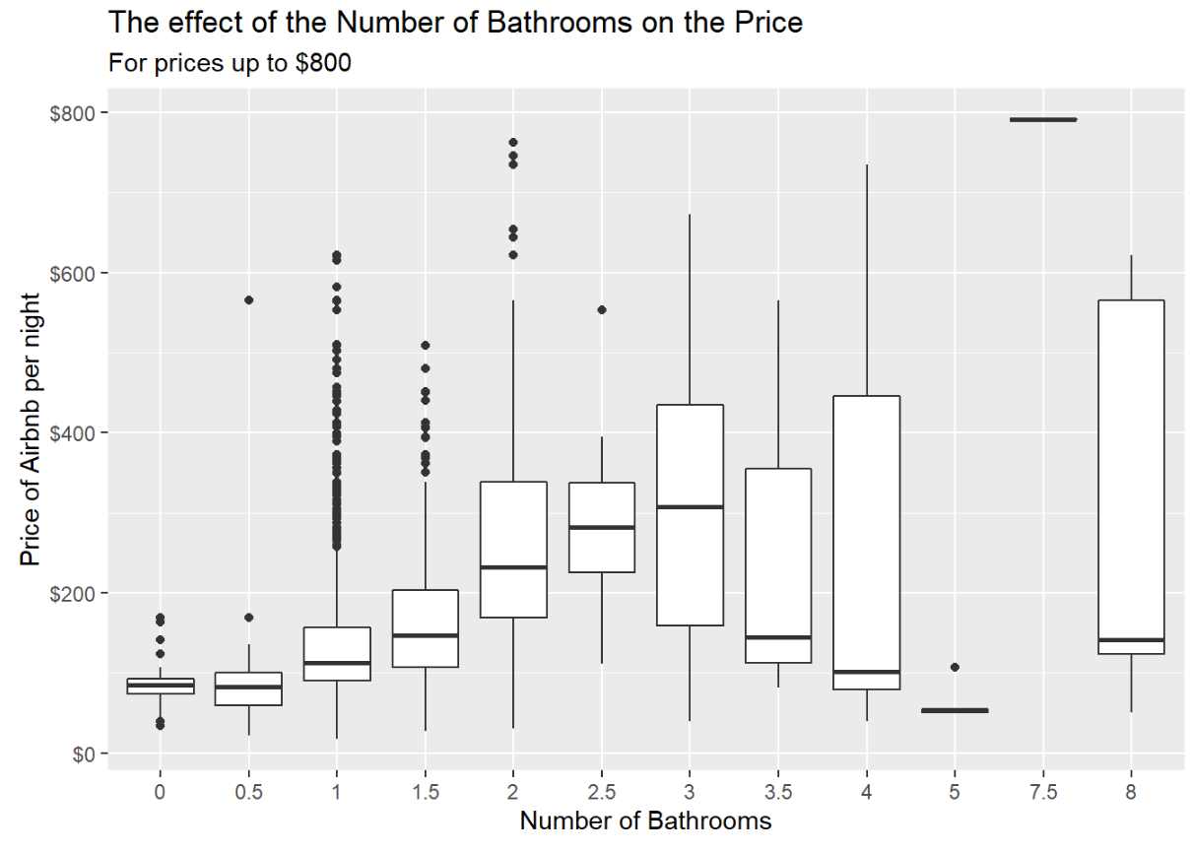
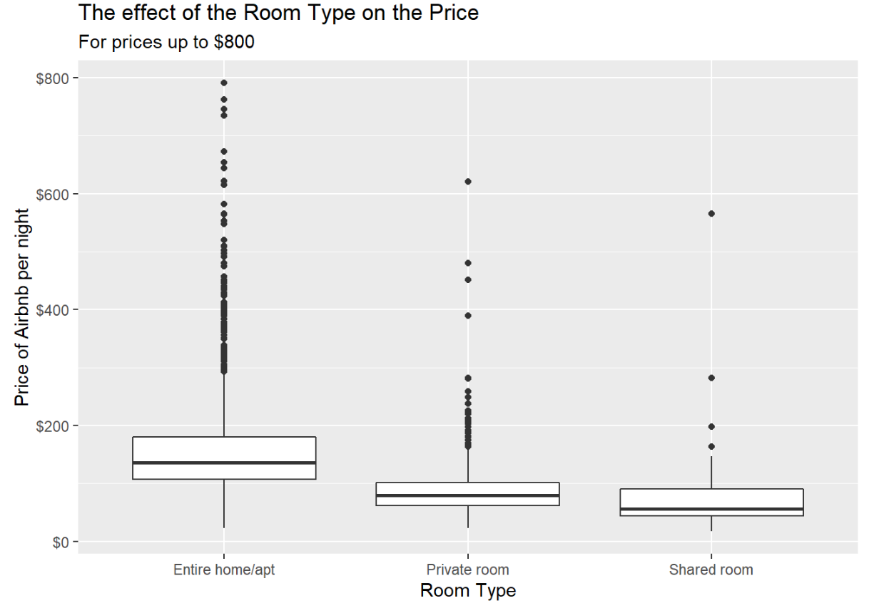
Exploratory Data Analysis & Visualizations
EDA
Created boxplots for each individual variable
Produced some linear regression models for some variables
Noted the r-squared values
Variable | R-squared
Bedrooms | 0.347
Bathrooms | 0.168
Overall Rating | 0.008

Slide 8
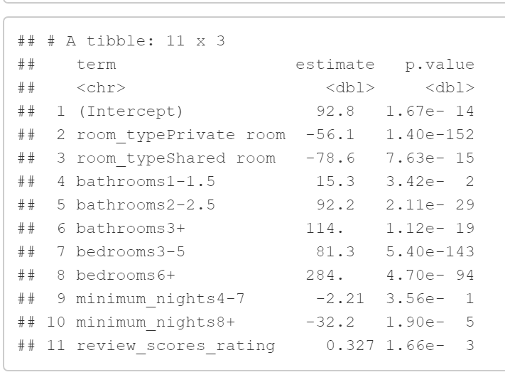
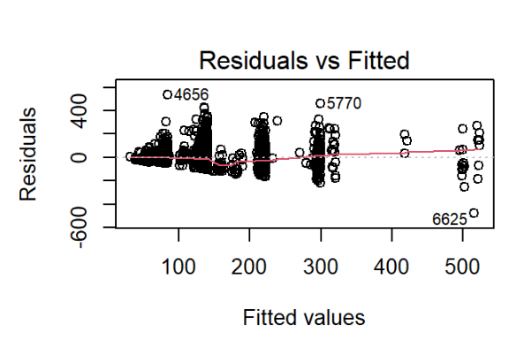
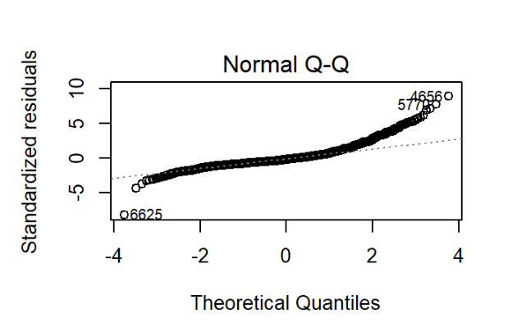
Beginning Model & Statistics
Model #1
Create levels within variables
5 variables included
Backwards Elimination
Adjusted R-squared = 0.379
Problem with variance and normality

Slide 9
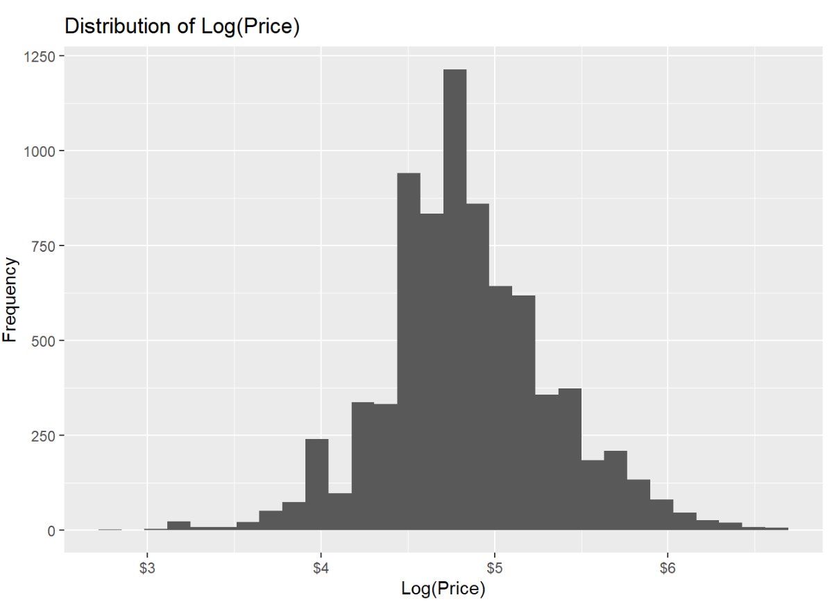
Transformation Time
Price data = Right-skewed -> Log transformation = Not skewed
New adjusted r-squared = 0.393

Slide 10
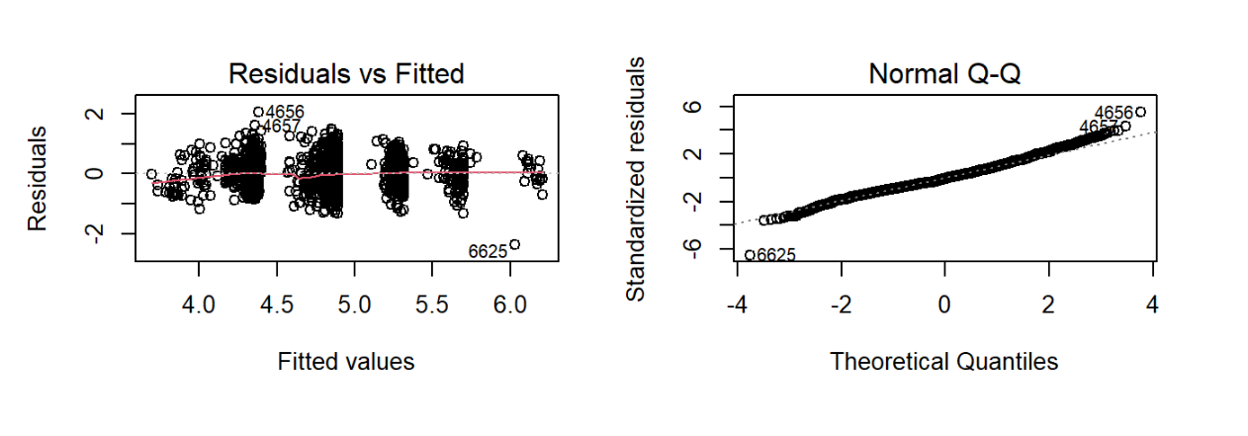
Transformation Time
Residual problem = fixed
Normality problem = fixed

Slide 11
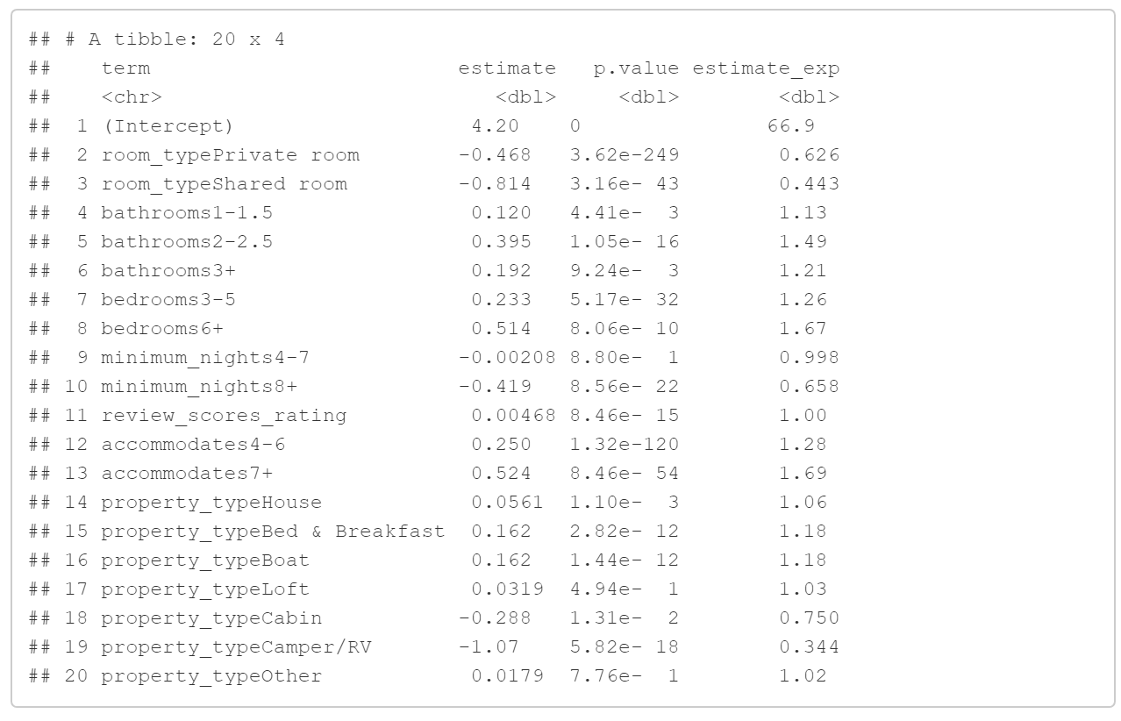
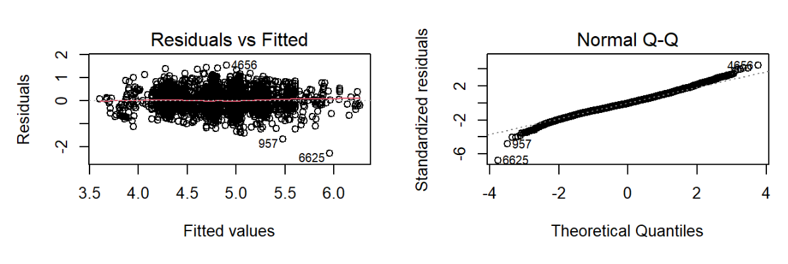
Final Model & Statistics
Can we produce a stronger model?
Property type & accommodates added
Model #2 & Final Model
Create levels within variables
7 total variables
Backwards Elimination
Adjusted r-squared = 0.472

Slide 12
Answers to Research Question
What factors have an impact the price of an Airbnb?
All 7 factors researched
Final model’s backward elimination results
Is there a combination of factors that have a strong effect on price?
7 variables instead of 5 variables
Adjusted r-squared values: 0.393 (5) vs. 0.472 (7)

Slide 13

Conclusion
Introduction of Data
EDA & Visualizations
Models & Statistics
Key Takeaways
Multiple variables are better than just 1!
Ways to fix residuals
Transformation and additional variables
Every part of the process is important!

Slide 14

Future Research
Explore the variable “city”
Would require lots of data wrangling
Geographic location vs. Price
Possibility of map plot using latitude and longitude
May have to filter by town or neighborhood
Transform overall rating variable
Left-skewedness creates difficulties

Slide 15

Thank you!

